Slide 1


POWER BI REPORT
Blinkit Sales Analysis and Performance review
GROUP 6
Abhinit Kumar - 2023JULB01008
Palak Agarwal - 2023JULB01009
Parnal Khobragade - 2023JULB01119
Prince Pritam - 2023JULB01012
Srishti Mishra - 2023JULB01233
Yashveer Singh - 2023JULB01191

Slide 2

PROBLEM STATEMENT
Conduct a comprehensive analysis of Blinkit's sales performance, customer satisfaction, and inventory distribution using Power BI.
The goal is to leverage key KPIs such as total sales, customer ratings, item visibility, and inventory turnover to uncover trends, regional disparities, and performance gaps. This analysis aims to deliver actionable insights for enhancing profitability, customer satisfaction, and inventory optimization.

Slide 3
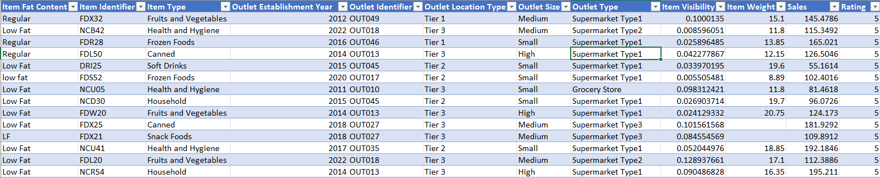
DOWNLOADED DATA
Source: The dataset was downloaded from Kaggle, a leading platform for data science and machine learning.
Dataset Description: Contains comprehensive data related to Blinkit’s sales, customer satisfaction metrics, and inventory distribution.
Key attributes include:
Sales Performance: insights into sales trends by product categories and outlets.
Customer Satisfaction: ratings and feedback for various product types and outlet locations.
Inventory Distribution: Details on item visibility, stock levels, and outlet characteristics.

Slide 4
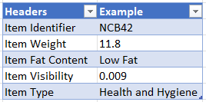
DATA UNDERSTANDING
Dataset Explanation:
Each row in the dataset represents a unique product entry for a specific outlet, capturing critical details about its sales, customer satisfaction, and inventory attributes. This data is used to analyze performance and identify trends at the item and outlet levels.
Column Descriptions:
Item Identifier: Unique identifier for each product in the inventory.
Example: FDW58 (represents a specific product).
Item Weight: Weight of the product in kilograms.
Used to assess product logistics and cost implications.
Item Fat Content: Indicates whether the product is Low Fat or Regular.
Useful for understanding customer preferences and dietary trends.
Item Visibility: Percentage visibility of the product in the outlet.
Higher visibility often correlates with better sales performance.
Item Type: Categorizes products into types, such as Beverages, Snacks, Fruits and Vegetables.
Enables analysis of category-level performance.

Slide 5

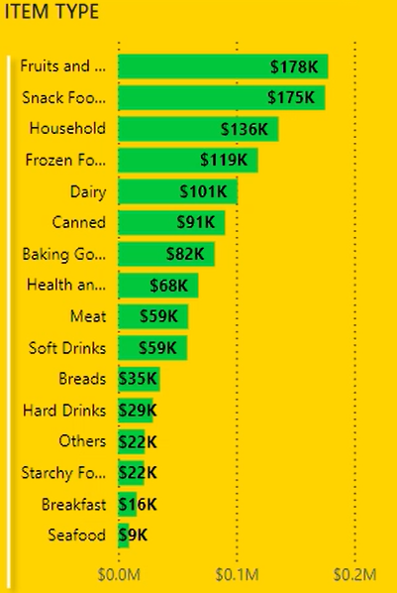
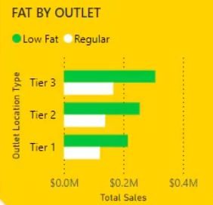
DATA ANALYSIS
UNIVARIATE ANALYSIS:
BI-VARIATE ANALYSIS:
Objective: Explore individual variables to understand their distribution and key statistics.
Objective: To explore and identify relationships or patterns between two variables, such as Fat analysis in different tier towns.

Slide 6
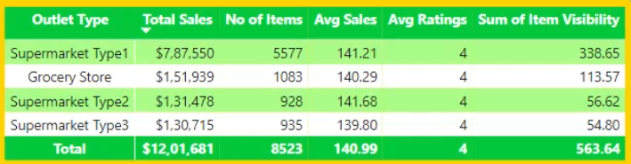
MULTI VARIATE ANALYSIS:
Objective: To analyze the combined relationships between multiple variables, such as outlet type, Avg Sales, and performance ratings, to uncover complex patterns and optimize decision-making.

Slide 7
DATA ANALYSIS
CHART’S REQUIREMENT:
1. Total Sales by Fat Content:
Objective: Analyse the impact of fat content on total sales.
Additional KPI Metrics: Assess how other KPIs (Average Sales, Number of Items, Average Rating) vary with fat content.
Chart Type: Donut Chart.
2. Total Sales by Item Type:
Objective: Identify the performance of different item types in terms of total sales.
Additional KPI Metrics: Assess how other KPIs (Average Sales, Number of Items, Average Rating) vary with fat content.
Chart Type: Bar Chart.
3. Fat Content by Outlet for Total Sales:
Objective: Compare total sales across different outlets segmented by fat content.
Additional KPI Metrics: Assess how other KPIs (Average Sales, Number of Items, Average Rating) vary with fat content.
Chart Type: Stacked Column Chart.
CHART’S REQUIREMENT:
4. Total Sales by Outlet Establishment:
Objective: Evaluate how the age or type of outlet establishment influences total sales.
Chart Type: Line Chart.
5. Sales by Outlet Size:
Objective: Analyse the correlation between outlet size and total sales.
Chart Type: Donut/ Pie Chart.
6. Sales by Outlet Location:
Objective: Assess the geographic distribution of sales across different locations.
Chart Type: Funnel Map.
7. All Metrics by Outlet Type:
Objective: Provide a comprehensive view of all key metrics (Total Sales, Average Sales, Number of Items, Average Rating) broken down by different outlet types.
Chart Type: Matrix Card.

Slide 8
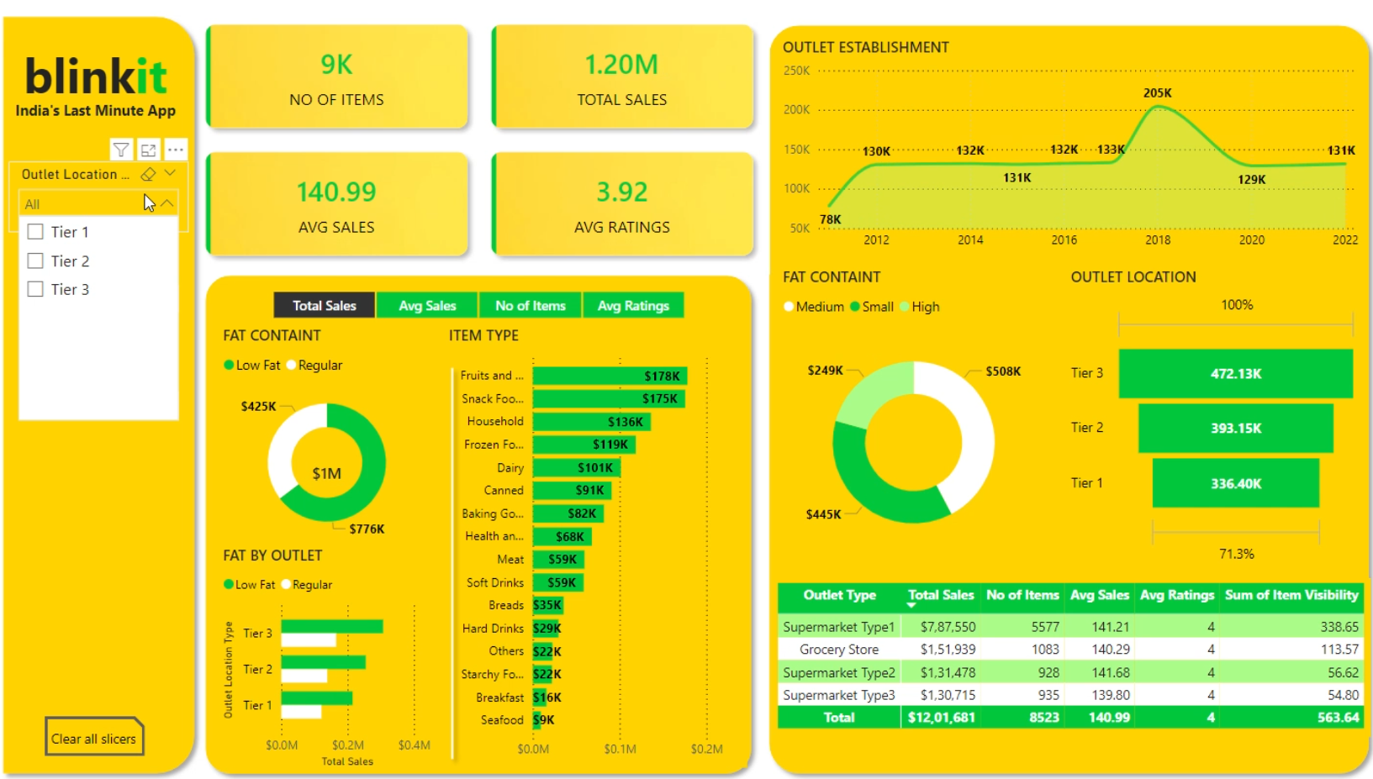
DASHBOARD CREATION:

Slide 9
BUSINESS SUGGESTION:
1. Identify the top-performing outlet location type in terms of total sales.
Solution: The dashboard visualizes total sales by outlet location type (Tier 1, Tier 2, Tier 3) on the right side. It shows that Tier 3 outlets have the highest total sales of $472.13K, indicating they are the top performers.
2. Determine the most popular item type in terms of total sales.
Solution: The bar chart in the middle section lists item types alongside their total sales. "Fruits and Vegetables" tops the list with $178K in sales, making it the most popular item type.
3. Analyze the trend in outlet establishment from 2012 to 2022.
Solution: The line graph in the top right corner shows the number of outlets established over time, revealing a peak in 2018 with 205K outlets and a general trend that can be used to understand business growth or decline.
4. Evaluate the impact of fat content on total sales and outlet performance.
Solution: The pie chart at the bottom left shows the breakdown of total sales by fat content (Low Fat vs. Regular), with regular fat items generating $1M in sales. Another chart shows how these sales vary across different outlet types, helping evaluate the impact.

Slide 10
THANK YOU

